Slide 1
NFT Pets
By: The Quagga Group
Ethan Silvas, Naomy Velasco, Karim Bouzina, and Jeff Crabill

Slide 2
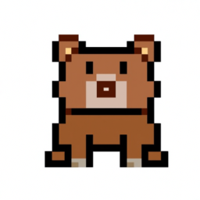


Mission Statement
Create NFT pets out of DALL-E generated pixel art images with functionality to chat with them via ChatGPT and buy/sell them on an Ethereum marketplace.

Slide 3
Project Goals
Build on what we learned about ERC721 tokens by creating an NFT marketplace
Leverage OpenAI APIs to integrate AI tools into a blockchain app
Combine the blockchain backend and Python Streamlit frontend to create full-stack dApp

Slide 4
Project Summary
Create a Solidity smart contract to create ERC721 tokens
Add functionality to buy and sell tokens between Ethereum addresses
Implement “middleman” to take 2% cut of every transaction
Use DALL-E API to generate unique pixel art NFT pets
Use ChatGPT API to create chat interactions between NFT pets
Put all of these elements together in a Streamlit UI with Metamask, Ganache, and Web3.py

Slide 5
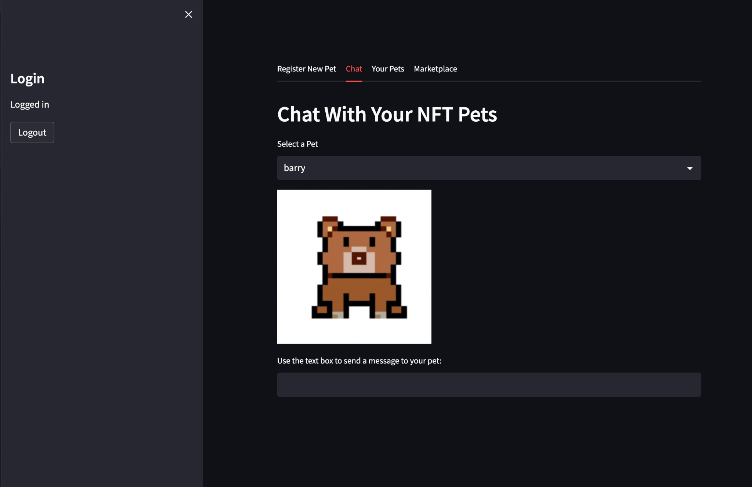

Slide 6
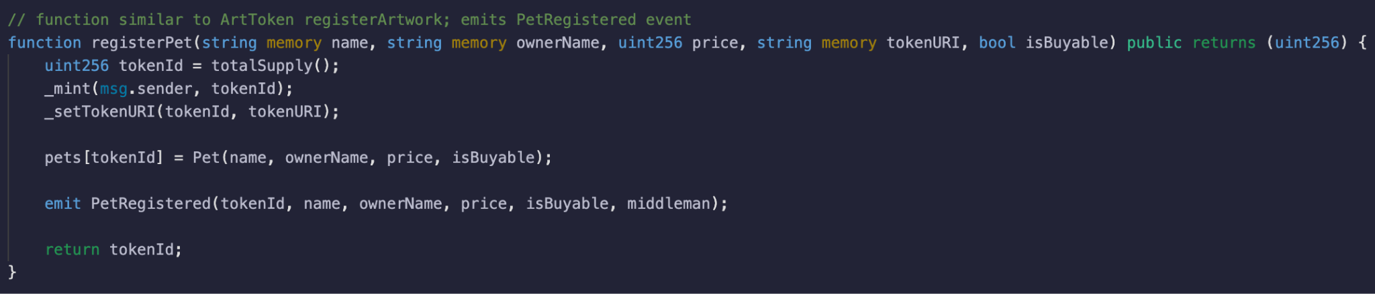
Building From ArtToken
Similar base logic to ArtToken
Use events to efficiently transfer information

Slide 7
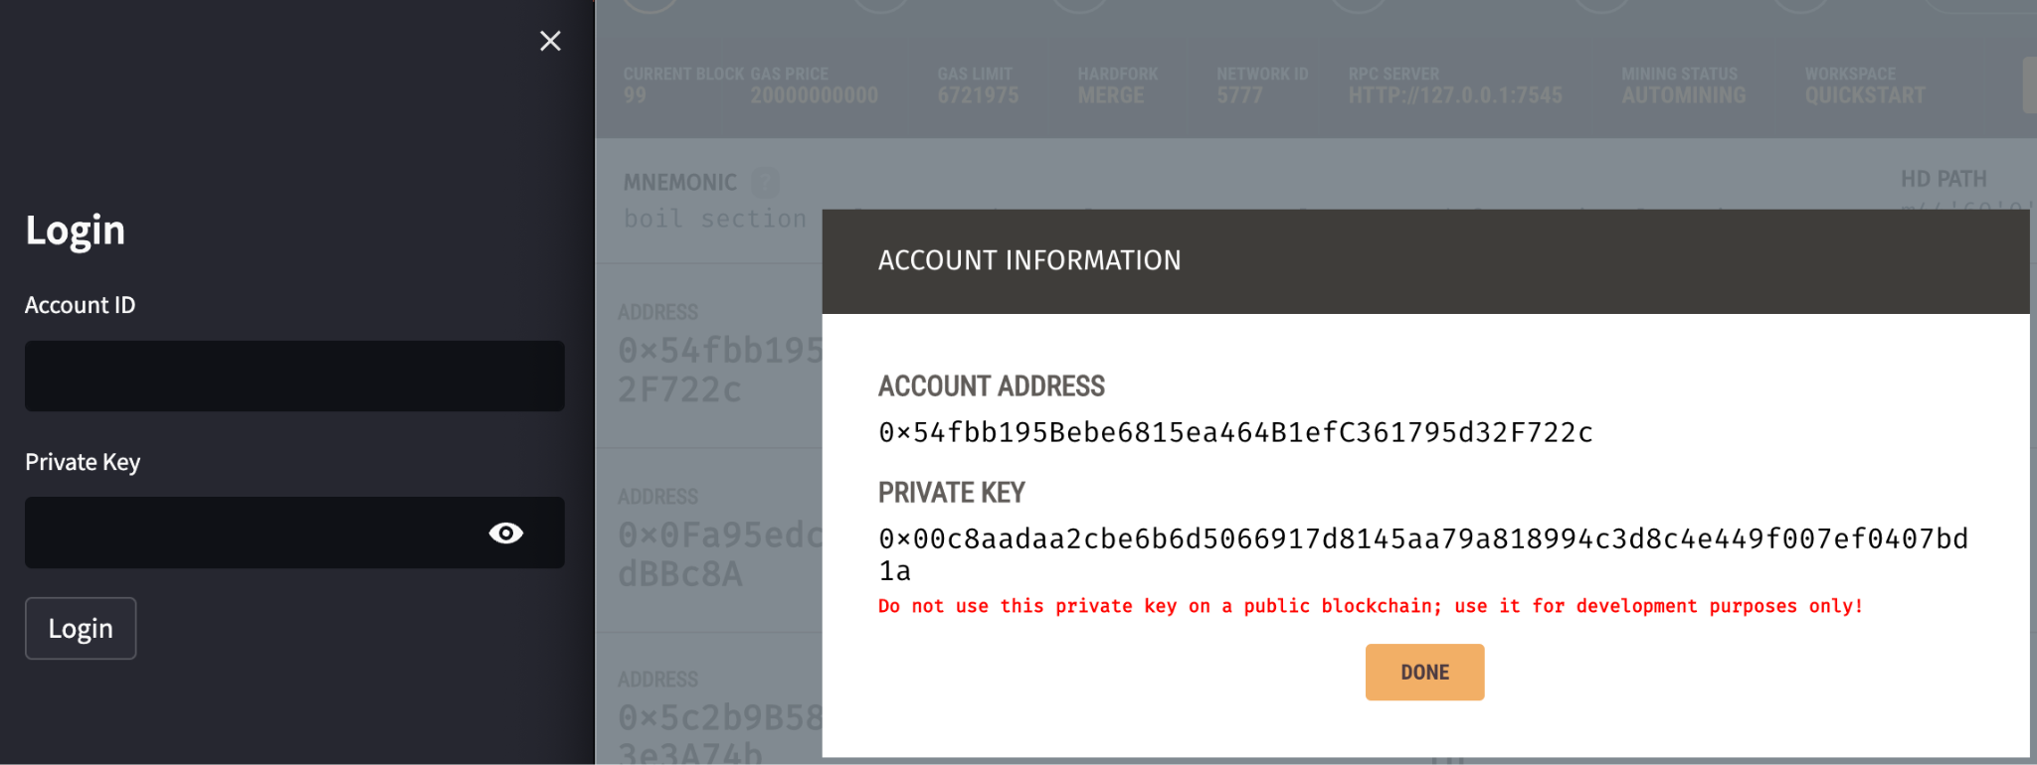
Add Login Capabilities With Ganache

Slide 8
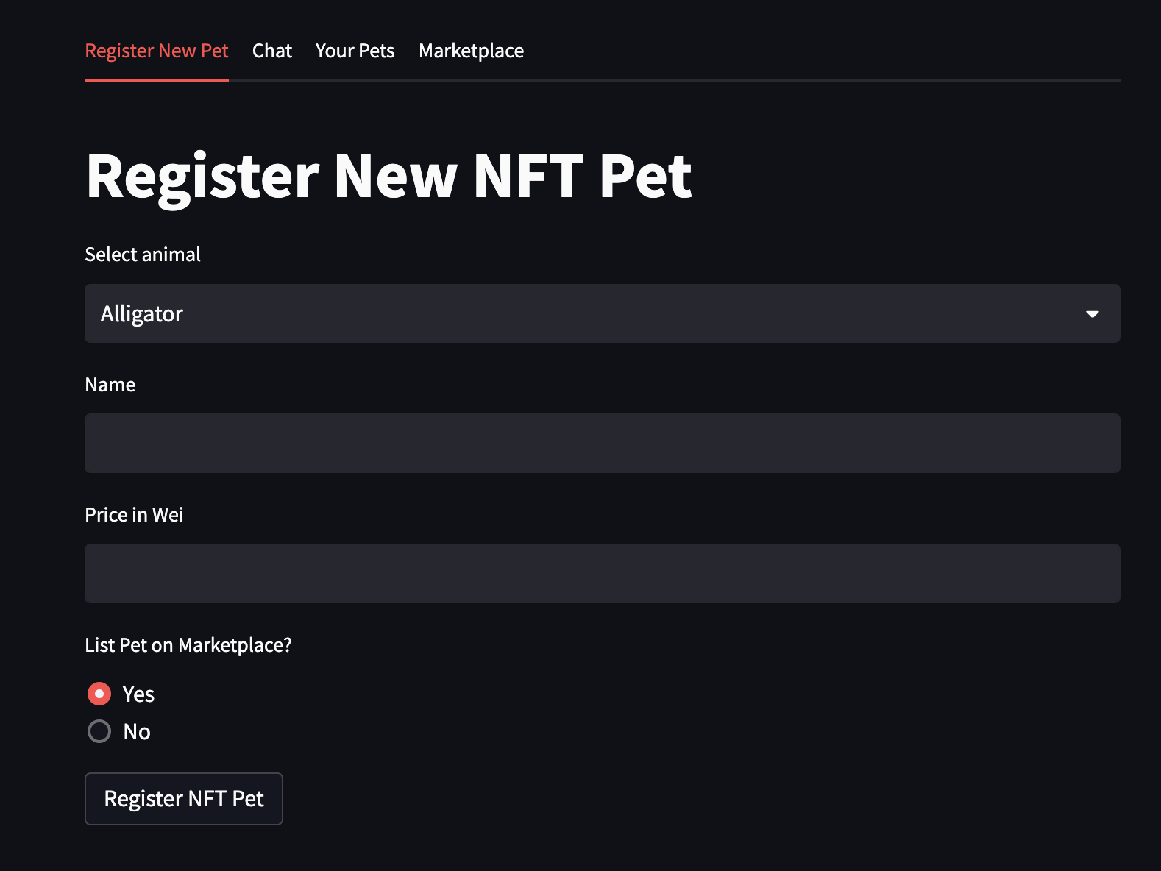
Register pets to logged in account
Add option to list on marketplace

Slide 9

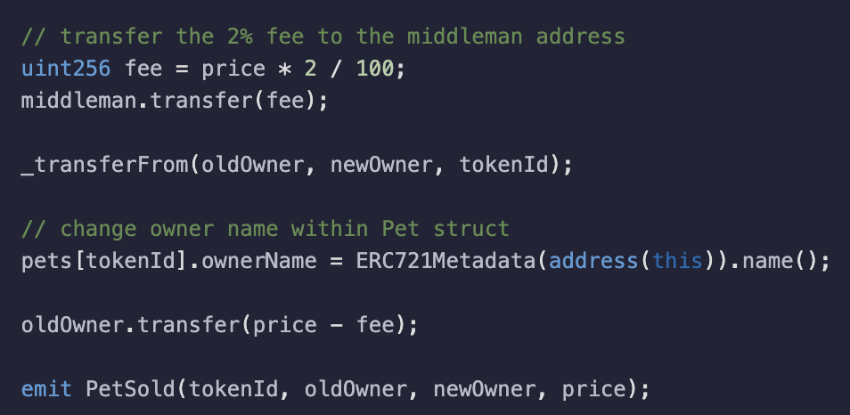

Slide 10
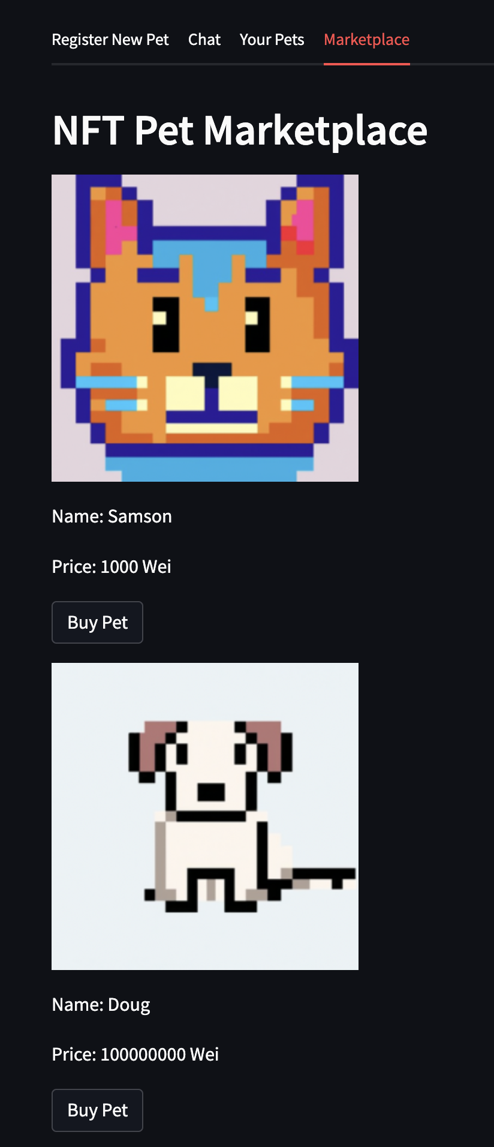
Use buyPet() to Create Marketplace
2% goes to address that deployed the smart contract
Ownership is immediately reflected after purchase

Slide 11
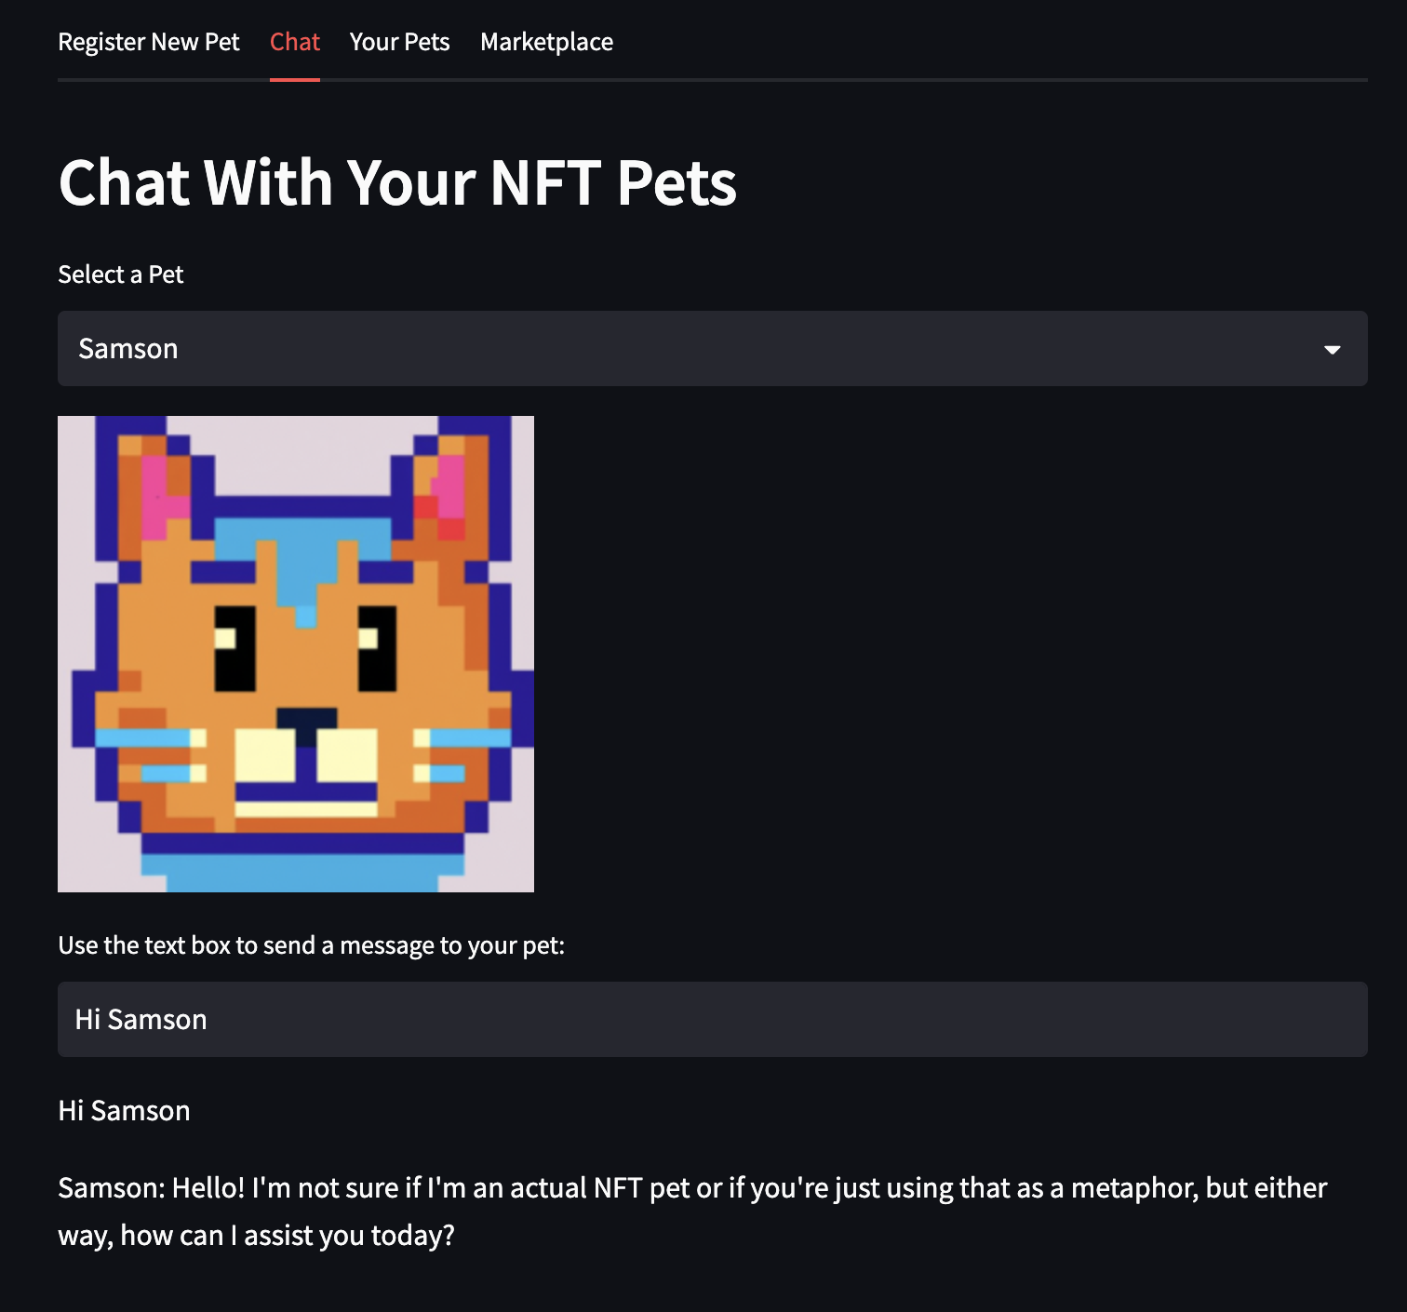
ChatGPT to Interact With Pets
Chat will continuously add to conversation
Can kind of give it a “personality”

Slide 12
OpenAI: DALL-E and ChatGPT APIs
Only a few lines of code!
Pay a small fee to generate images and interact with chat
Relatively fast response times

Slide 13
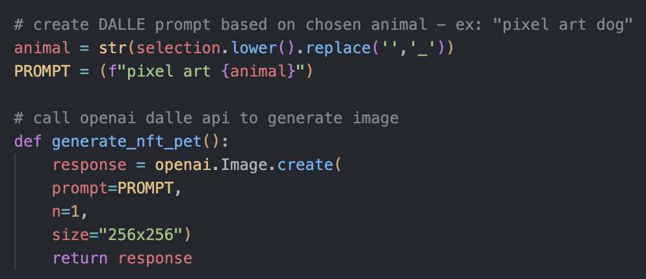
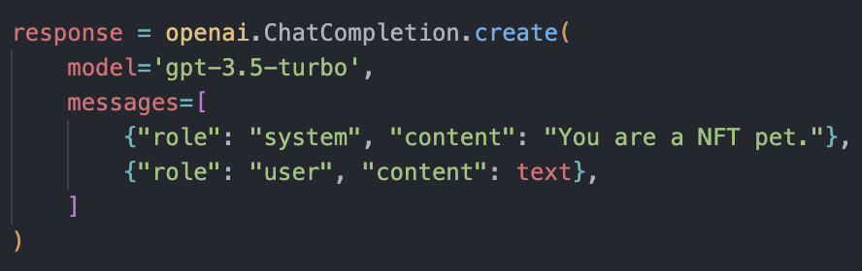

Slide 14
Results
Successfully created marketplace transactions that were managed by UI and smart contract
Integrated OpenAI APIs for out of the box AI tools
Created a dApp with a frontend that combines the blockchain backend and AI tools

Slide 15
Issues
Not 100% ready to deploy as an actual app
UI bugs
Needs Metamask login/logout integration
DALL-E images aren’t saved forever and enabling them to do so might cost more
Web3.js offers more support than Web3.py

Slide 16
Next Steps
Deploy the app
Convert to JavaScript/React.js UI instead of Streamlit
Implement Metamask login/logout functionality for better security
Add more marketplace features
Modify your listings
See your sales and profit history
Implement Pokemon-like game features

Slide 17
Thank You!

